Slide 1

Drone Vs Bird Classification

Slide 2


GROUP 12
Course: Foundations of Machine Learning Frameworks (CSCN8010)
Presented by:
Daya Meenakshi Bala Subbu (8964370)
Bismi Poulose (8981107)

Slide 3


Introduction
Objective
Classify images as either bird or drone using deep learning.
Vision:
Reliable aerial object detection is crucial in airspace security and wildlife protection.
Method:
Apply Convolutional Neural Networks (CNN), VGG16 and MobilenetV2 model for image classification.

Slide 4

Dataset Description
Source: Kaggle - Drone vs Bird Dataset
Feature Description:
Contains labeled images of drones and birds.
Applied train and validate split and preprocessing steps.

Slide 5

Steps for Classification
1. Data Loading & Preprocessing.
2. CNN, VGG16 and MobileNetV2 model
3. Model Compilation
4. Model Training (Epochs & Batch size)
5. Evaluation (Confusion Matrix, Accuracy)

Slide 6

Machine Learning Models
CNN Model
VGG16 Model
MobileNetV2 Model

Slide 7
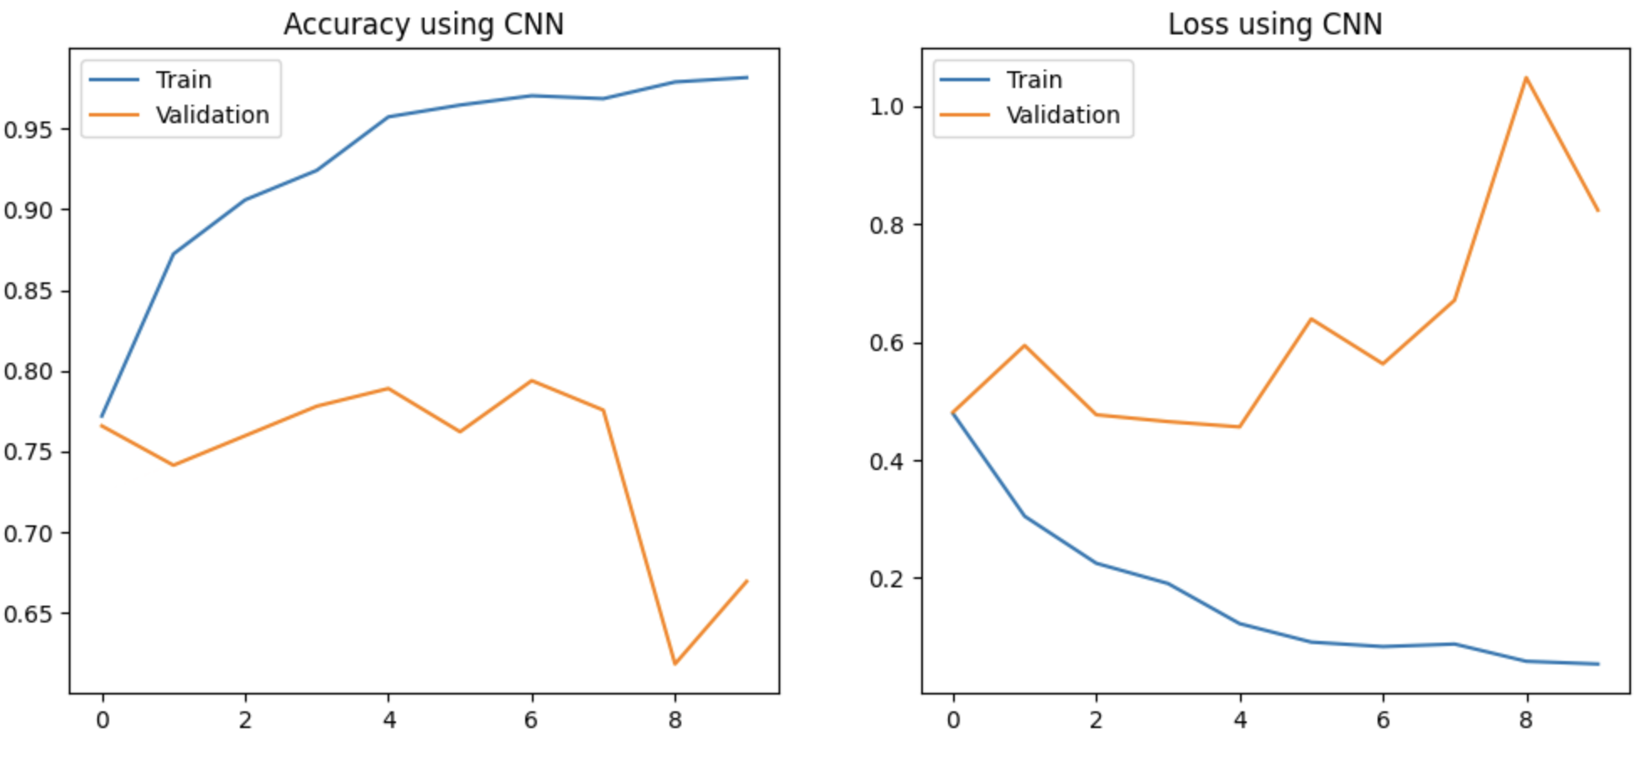
Training Performance and Model Evaluation for CNN
Loss and accuracy monitored over epochs.
Model shows decreasing loss trend and improving accuracy.
Vi

Slide 8
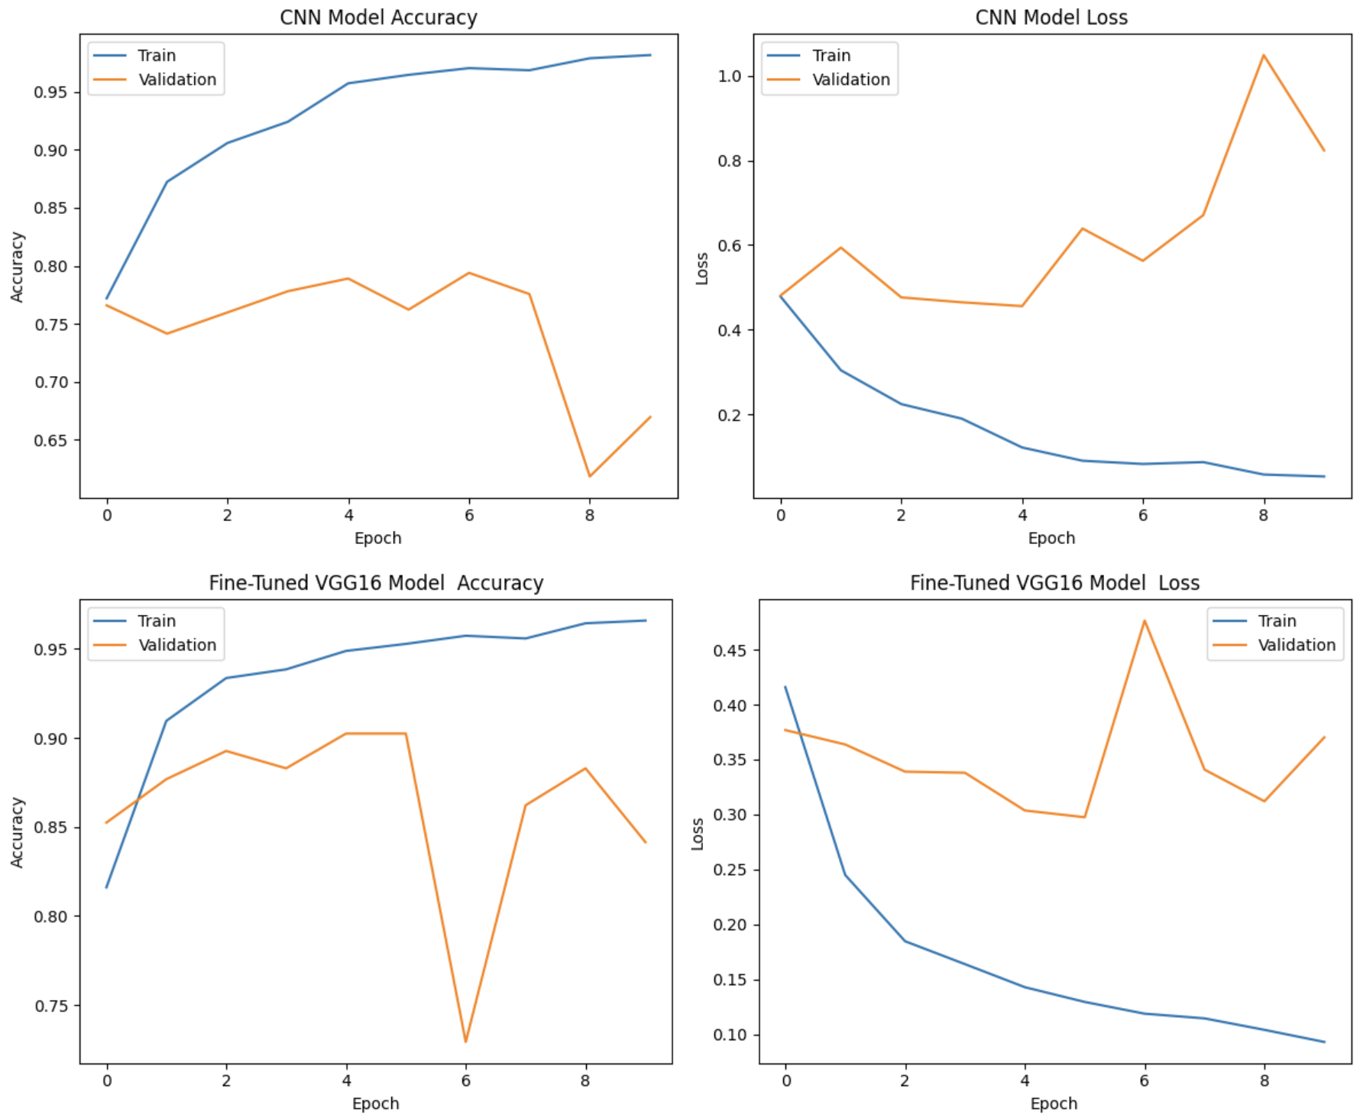
Hyperparameter Tuning using VGG16
VGG16, a pre-trained convolutional neural network, to enhance our model's performance through transfer learning.
Comparison of CNN and VGG16
CNN Model:
Accuracy: 0.7646
Loss: 0.7492
VGG16 Model:
Accuracy: 0.8866
Loss: 0.3201

Slide 9
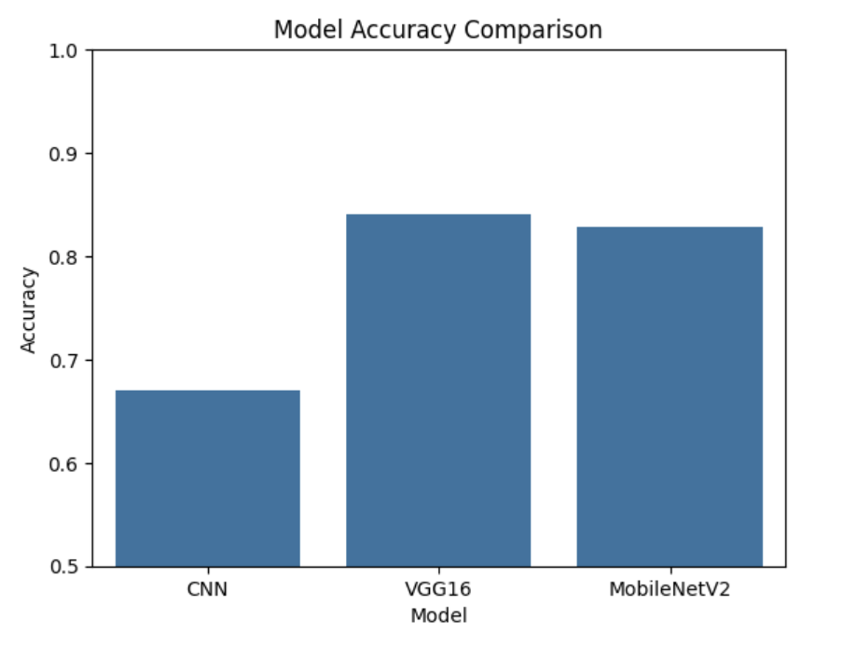
Challenges Faced
Variability in image sizes and quality.
Imbalanced data during initial stages.
Model overfitting in early trials.
Fine Tuning – MobileNetV2 model Comparison with other Models
Model Accuracy Comparsion
CNN | 76.4%
VGG16 | 88.6%
MobileNetV2 | 81.2%

Slide 10
References
Sarwar, M. S. (n.d.). Drone vs Bird Dataset [Dataset].Kaggle.
https://www.kaggle.com/datasets/muhammadsaoodsarwar/drone-vs-bird/data

Slide 11
Thank You

